Slide 1
Symmetries in Reinforcement Learning
Reinforcement Learning
Summer School Amsterdam 2022
Elise van der Pol

Slide 2
About me
Senior Researcher @ Microsoft Research Amsterdam:
Reinforcement Learning & Deep Learning for Molecular Simulation
Find me online:
📧 evanderpol@microsoft.com
@ElisevanderPol
🌐 elisevanderpol.nl

Slide 3
About me
Senior Researcher @ Microsoft Research Amsterdam:
Reinforcement Learning & Deep Learning for Molecular Simulation
→ We’ll soon be hiring research engineers.
Find me online:
📧 evanderpol@microsoft.com
@ElisevanderPol
🌐 elisevanderpol.nl

Slide 4
About me
Senior Researcher @ Microsoft Research Amsterdam:
Reinforcement Learning & Deep Learning for Molecular Simulation
Before: PhD in Machine Learning @ AMLab, University of Amsterdam
Symmetry and Structure in Deep Reinforcement Learning
→ We’ll soon be hiring research engineers.
Find me online:
📧 evanderpol@microsoft.com
@ElisevanderPol
🌐 elisevanderpol.nl

Slide 5
Today’s Lecture
Three pillars:
Reinforcement Learning recap + motivating today’s topic
Necessary background
Symmetries & Equivariance in Deep Reinforcement Learning

Slide 6
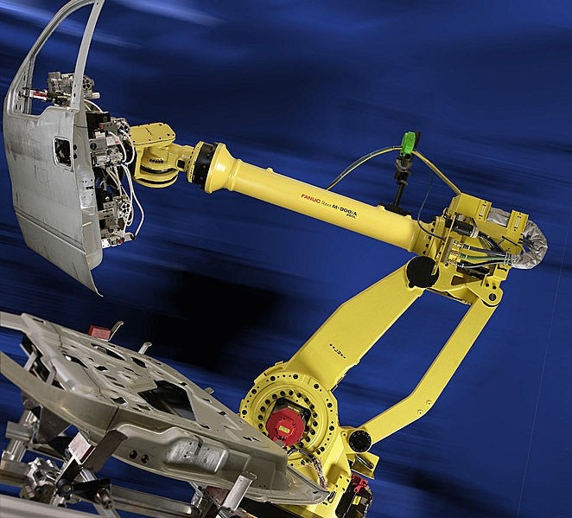
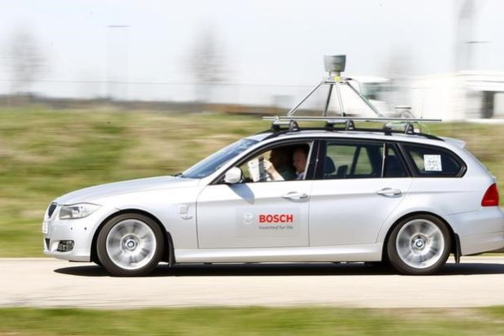
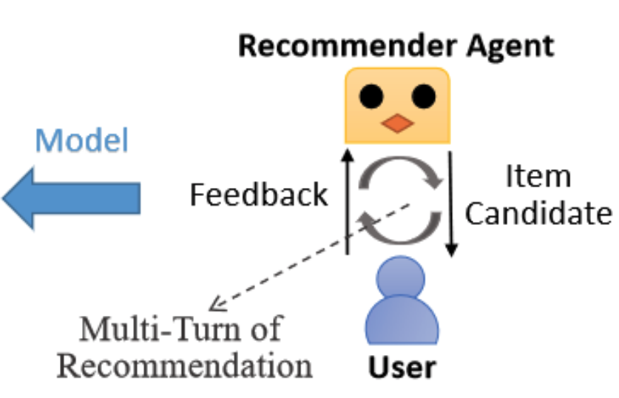
(Lin et al 2020)

Slide 7
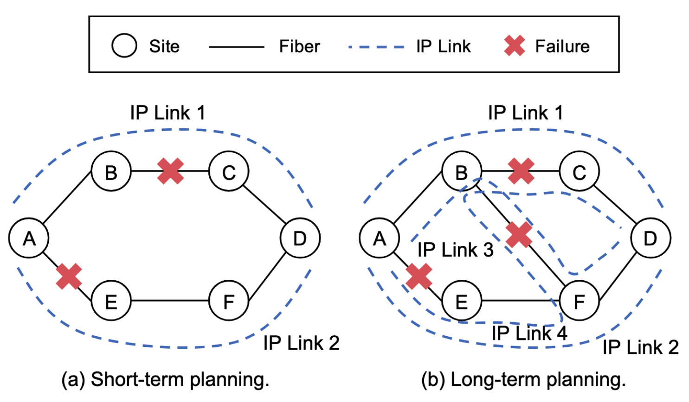
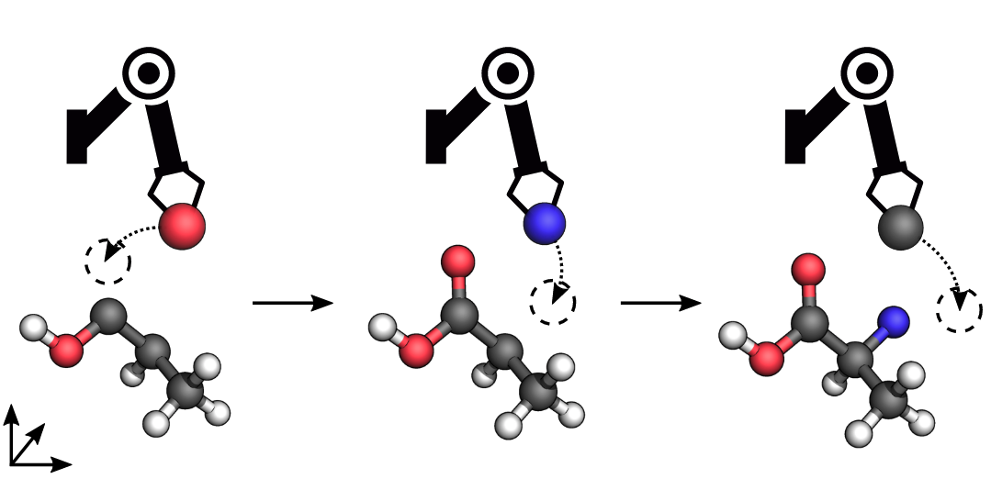
Chip Placement with Deep Reinforcement Learning (Mirhoseini et al 2020)
Reinforcement learning for molecular design guided by quantum mechanics (Simm et al 2020)
Network planning with deep reinforcement learning (Zhu et al 2020)

Slide 8
What is Reinforcement Learning?
action
state,
reward
Learning from trial and error

Slide 9
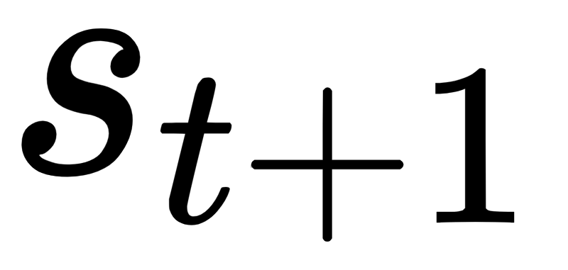
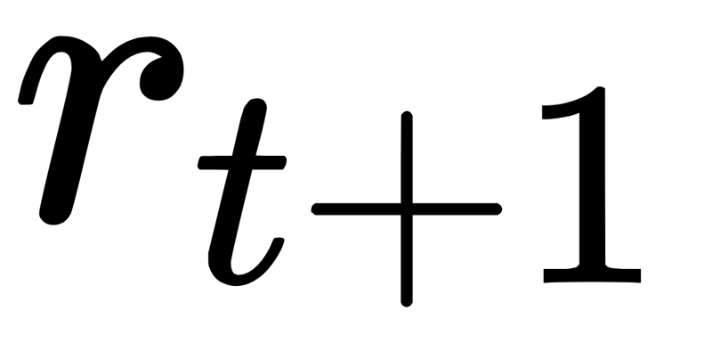
What is Reinforcement Learning?
Markov Decision Process (MDP):

Slide 10
What is Reinforcement Learning?
Markov Decision Process (MDP):
states

Slide 11
What is Reinforcement Learning?
actions
Markov Decision Process (MDP):
states

Slide 12
What is Reinforcement Learning?
actions
Markov Decision Process (MDP):
states
transition function

Slide 13
What is Reinforcement Learning?
actions
reward function
Markov Decision Process (MDP):
states
transition function

Slide 14
What is Reinforcement Learning?
actions
reward function
Markov Decision Process (MDP):
MDP Dynamics
states
transition function

Slide 15
What is Reinforcement Learning?
policy
Goal: Policy that maximizes cumulative reward

Slide 16
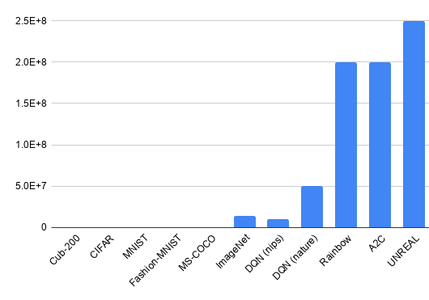
Reinforcement learning is very data hungry
Number of samples
Sampling is slow and there is a real world cost to low reward states
Notes:
imagenet = 14 million

Slide 17
Not all data is unique!
(from https://openreview.net/pdf?id=a3NaSCJ20V)
?
?
≠
≠
Notes:
https://openreview.net/pdf?id=a3NaSCJ20V

Slide 18
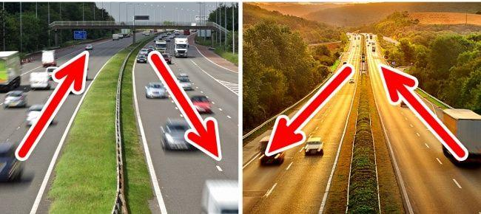
Not all data is unique!
(from https://openreview.net/pdf?id=a3NaSCJ20V)
?
?
≠
≠
Cambridge Amsterdam
Notes:
https://openreview.net/pdf?id=a3NaSCJ20V

Slide 19
Some Background

Slide 20
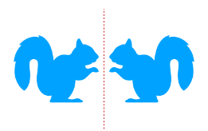
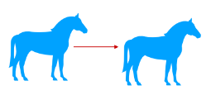
What is a group?
Examples:
A set with a binary operation obeying the group axioms
(identity, invertibility, closure, associativity)
Translations Reflections Rotations
Figures from Daniel Worrall’s MLSS slides

Slide 21
Group Axioms
Identity:
$$∃e∈G, ∀g∈G: e⋅g=g⋅e=g$$
Invertibility:
$$∀g∈G, ∃g^{−1}∈G:g⋅g^{−1}=g^{−1}⋅g=e$$
Associativity:
$$∀g_{1},g_{2},g_{3}∈G:{(g}_{1}⋅g_{2})⋅g_{3}=g_{1}⋅(g_{2}⋅g_{3})$$
Closure
$$∀g_{1},g_{2}∈G:g_{1}⋅g_{2}∈G$$
e.g. the 0 degree rotation
e.g. 90 degree and -90 degree rotation
Bracket order does not matter
e.g. 90 * 180 = 270 degree rotation

Slide 22
Further Reading
Dummit & Foote – Abstract Algebra
Tung – Group Theory in Physics
Chirikjian – Engineering Applications of Noncommutative Harmonic Analysis
Gowers - The Princeton Companion to Mathematics
Stone – Mathematics for Physics
Serre - Linear Representations of Finite Groups

Slide 23
Equivariant network: f is a neural net
Equivariance
f ( g x ) = g’ f ( x )
Invariance
f ( g x ) = f ( x )
g’
f
f
f
f
g
g
Figures adapted from Daniel E. Worrall

Slide 24
Example: 90 Degree Rotational Equivariant Network
A
A
Rotating the image results in a permutation of the activations/features.
We can propagate rotation information through the network layer by layer.

Slide 25
Learning more about equivariant networks
Courses
https://geometricdeeplearning.com/lectures/
Course by Michael M. Bronstein, Joan Bruna, Taco Cohen, Petar Veličković, at the African Master’s in Machine Intelligence
https://uvagedl.github.io/
Course by Erik Bekkers, at the University of Amsterdam
Code
https://e3nn.org/
https://github.com/mfinzi/equivariant-MLP
https://github.com/ElisevanderPol/symmetrizer
Further reading
Teo & Hel-Or. “Lie Generators for Computing Steerable Functions.” Pattern Recognition Letters, 1998.
Cohen & Welling. "Group equivariant convolutional networks." ICML, 2016.
Worrall et al. "Harmonic networks: Deep translation and rotation equivariance.“ CVPR, 2017.
Weiler et al. “Learning steerable filters for rotation equivariant CNNs.”, CPVR, 2018
Thomas et al. "Tensor field networks: Rotation-and translation-equivariant neural networks for 3d point clouds." Arxiv Preprint, 2018.
Maron et al. “Invariant and equivariant graph networks.” ICLR, 2019.
Finzi et al. “Generalizing convolutional neural networks for equivariance to lie groups on arbitrary continuous data.” ICML. 2020
Brandstetter et al. "Geometric and physical quantities improve E (3) equivariant message passing." ICLR, 2022.

Slide 26
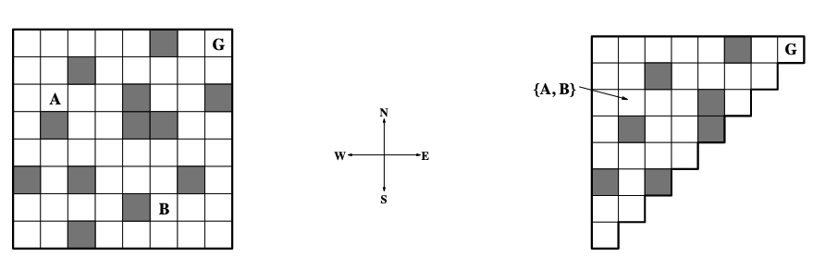
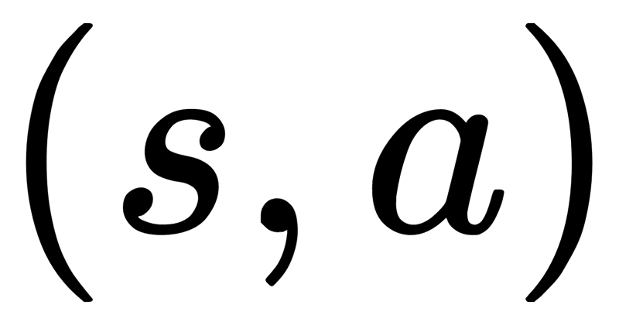
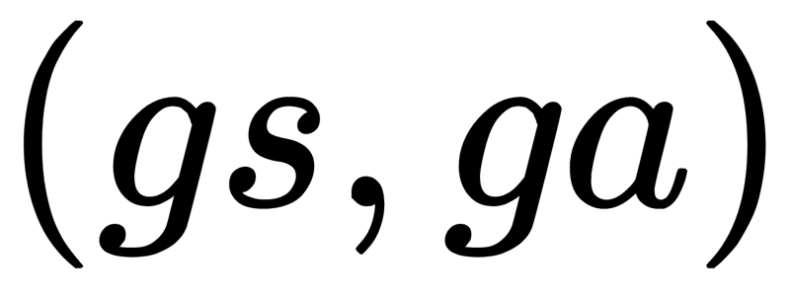
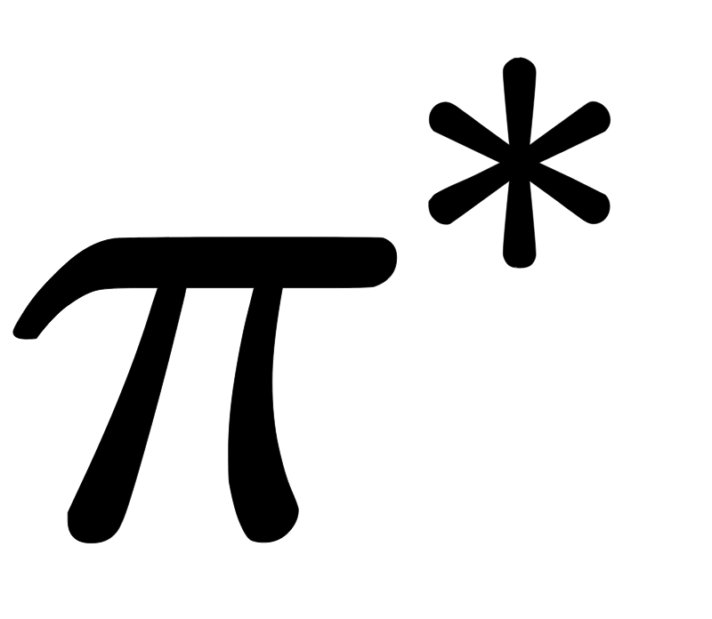
Symmetries in Reinforcement Learning
For all states and actions, and all group elements:
Dynamics are invariant under group transformations
and are symmetric state-action pairs and have the same
(Ravindran & Barto 2004)

Slide 27
Equivalence Relations
Let $B$ be a relation on $S$. We write $xBy$ if the relation holds between $x∈S$ and $y∈S$.
Example: $x< y$
$B$ is an equivalence relation on $S$ if and only if:
$B$ is reflexive:
$xBx$ $∀x∈S$
$B$ is symmetric:
$xBy↔yBx$ $∀x, y∈S$
$B$ is transitive:
if $xBy$ and $yBz$ then $xBz$ $∀x, y, z∈S$
Examples:
“=” (numbers),
“Has the same birthday as” (people),

Slide 28
Example “Is in the same row as”
Reflexive? Yes
Symmetric? Yes
Transitive? Yes
Equivalence relation
A
B
C
D
E
F
G

Slide 29
Example “Is smaller than or equal to”
Reflexive? Yes
Symmetric? No
Transitive? Yes
$$1≤10$$
$$10≤20$$
NOT Equivalence relation

Slide 30
Partitions and Equivalence Classes
An equivalence relation $B$ on a space $S$ partitions $S$. We write $S/B$ for the partition of $S$ under $B$.
A partition $S/B$ is a collection of disjoint non-empty subsets $X_{i}∈S/B$ of S whose union forms S:
$$S=\bigcup_{X_{i}∈S/B}{X_{i}}$$
$X_{i}∩X_{j}=∅$ $∀i≠j$
The equivalence class of an element $x$ under equivalence relation $B$ is
$${\left[x\right]}_{B}=\{y∈S |xBy\}$$
The blocks of the partition $S/B$ are the equivalence classes of$B$.
A
B
C
D
E
F
G

Slide 31
Bisimulation
Equivalence relation on MDP satisfying
$sBs^{′}↔∀a∈A:(r\left(s, a\right)=r\left(s^{′}, a\right)$ and $∀C∈S/B$, $T\left(s, a, C\right)=T\left(s^{′}, a C\right))$

Slide 32
Bisimulation
Equivalence relation on MDP satisfying
$sBs^{′}↔∀a∈A:(r\left(s, a\right)=r\left(s^{′}, a\right)$ and $∀C∈S/B$, $T\left(s, a, C\right)=T\left(s^{′}, a C\right))$
s and s’ are bisimilar iff

Slide 33
Bisimulation
Equivalence relation on MDP satisfying
$sBs^{′}↔∀a∈A:(r\left(s, a\right)=r\left(s^{′}, a\right)$ and $∀C∈S/B$, $T\left(s, a, C\right)=T\left(s^{′}, a C\right))$
for every action

Slide 34
Bisimulation
Equivalence relation on MDP satisfying
$sBs^{′}↔∀a∈A:(r\left(s, a\right)=r\left(s^{′}, a\right)$ and $∀C∈S/B$, $T\left(s, a, C\right)=T\left(s^{′}, a C\right))$
rewards are invariant

Slide 35
Bisimulation
Equivalence relation on MDP satisfying
$sBs^{′}↔∀a∈A:(r\left(s, a\right)=r\left(s^{′}, a\right)$ and $∀C∈S/B$, $T\left(s, a, C\right)=T\left(s^{′}, a C\right))$
and for each block in the partition

Slide 36
Bisimulation
Equivalence relation on MDP satisfying
$sBs^{′}↔∀a∈A:(r\left(s, a\right)=r\left(s^{′}, a\right)$ and $∀C∈S/B$, $T\left(s, a, C\right)=T\left(s^{′}, a, C\right))$
transition probabilities are invariant

Slide 37
Bisimulation
Equivalence relation on MDP satisfying
$sBs^{′}↔∀a∈A:(r\left(s, a\right)=r\left(s^{′}, a\right)$ and $∀C∈S/B$, $T\left(s, a, C\right)=T\left(s^{′}, a C\right))$
Intuitively: $s$ and $s^{′}$ are equivalent if
> They have the same rewards
> They have the same transition probabilities to other blocks in the partition $S/B$
Blocks: aggregate states/abstract states

Slide 38
Example MDP
> Reduce the MDP in size using the bisimulation relation
a₁
a₁
r=0
r=0
s₁
s₂
a₂
a₂
s₃
r=1

Slide 39
Example MDP
> Reduce the MDP in size using the bisimulation relation
a₁
a₁
a₁
r=0
B₁
r=0
s₁
s₂
a₂
a₂
a₂
s₃
B₂
r=1
r=1
$$S/B=\{ \left\{s_{1},s_{2}\right\}, \left\{s_{3}\right\}\}$$

Slide 40
Issues with Bisimulation Relations
Equivalence: no ‘soft similarity’. Perfect match or bust.

Slide 41
Issues with Bisimulation Relations
Equivalence: no ‘soft similarity’. Perfect match or bust.
Solution: (semi) metrics based on bisimulations

Slide 42
Issues with Bisimulation Relations
Equivalence: no ‘soft similarity’. Perfect match or bust.
Solution: (semi) metrics based on bisimulations
State-space equivalence: no way to deal with symmetries in state-action space

Slide 43
Issues with Bisimulation Relations
Equivalence: no ‘soft similarity’. Perfect match or bust.
Solution: (semi) metrics based on bisimulations
State-space equivalence: no way to deal with symmetries in state-action space
Solution: lax bisimulations and MDP homomorphisms

Slide 44
Issues with Bisimulation Relations
Equivalence: no ‘soft similarity’. Perfect match or bust.
Solution: (semi) metrics based on bisimulations
State-space equivalence: no way to deal with symmetries in state-action space
Solution: lax bisimulations and MDP homomorphisms
Expensive to compute, not feasible in high dimensional and/or continuous MDPs

Slide 45
Issues with Bisimulation Relations
Equivalence: no ‘soft similarity’. Perfect match or bust.
Solution: (semi) metrics based on bisimulations
State-space equivalence: no way to deal with symmetries in state-action space
Solution: lax bisimulations and MDP homomorphisms
Expensive to compute, not feasible in high dimensional and/or continuous MDPs
Solution: active area of research

Slide 46
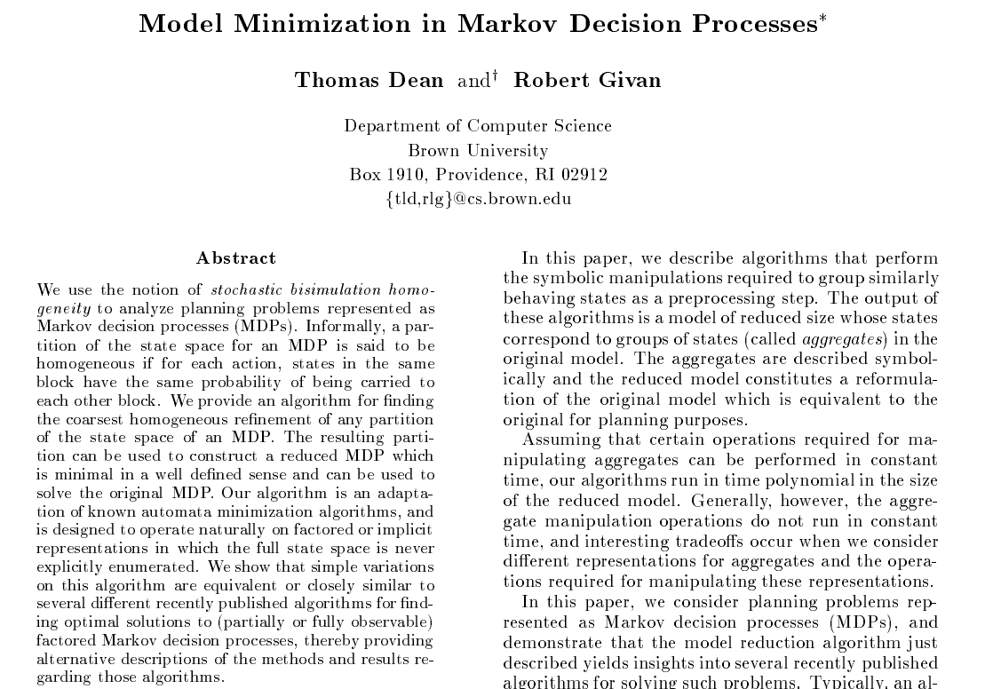
Further Reading
Bisimulation for aggregating MDP states.
Iterative splitting algorithm to find coarsest partition.

Slide 47
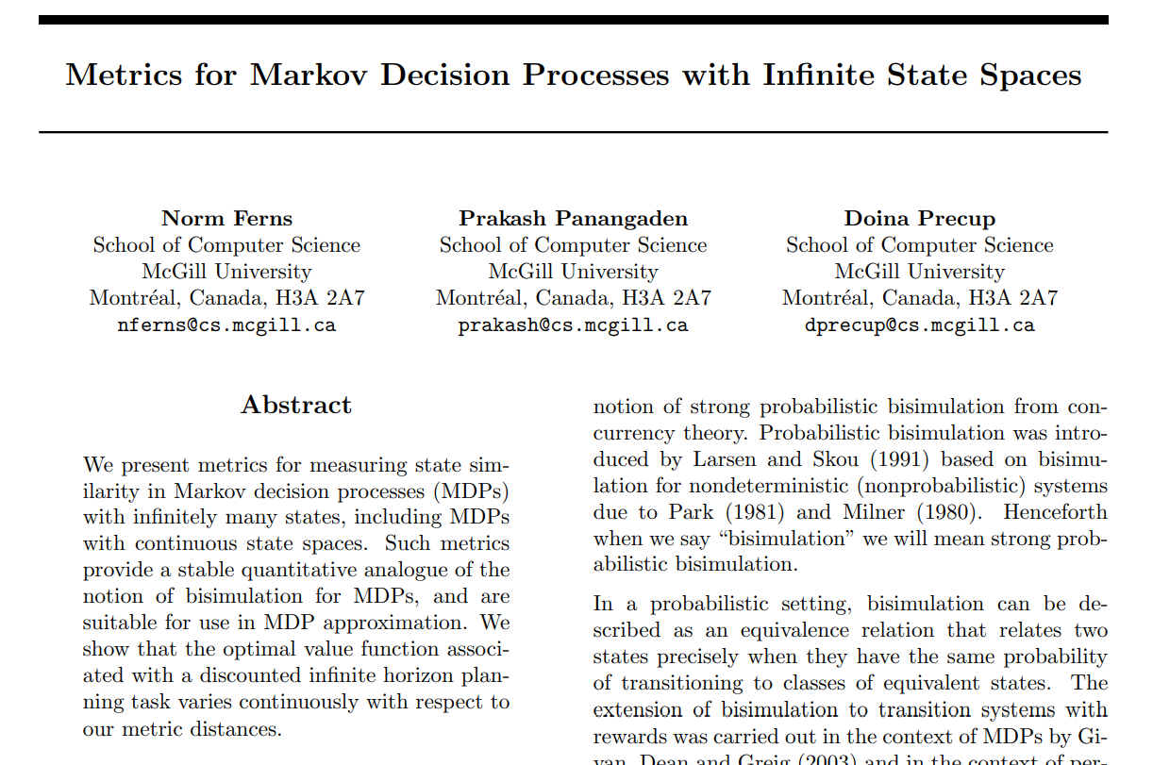
Further Reading
Metrics for state similarity in MDPs.
“soft” version of bisimulation equivalence

Slide 48
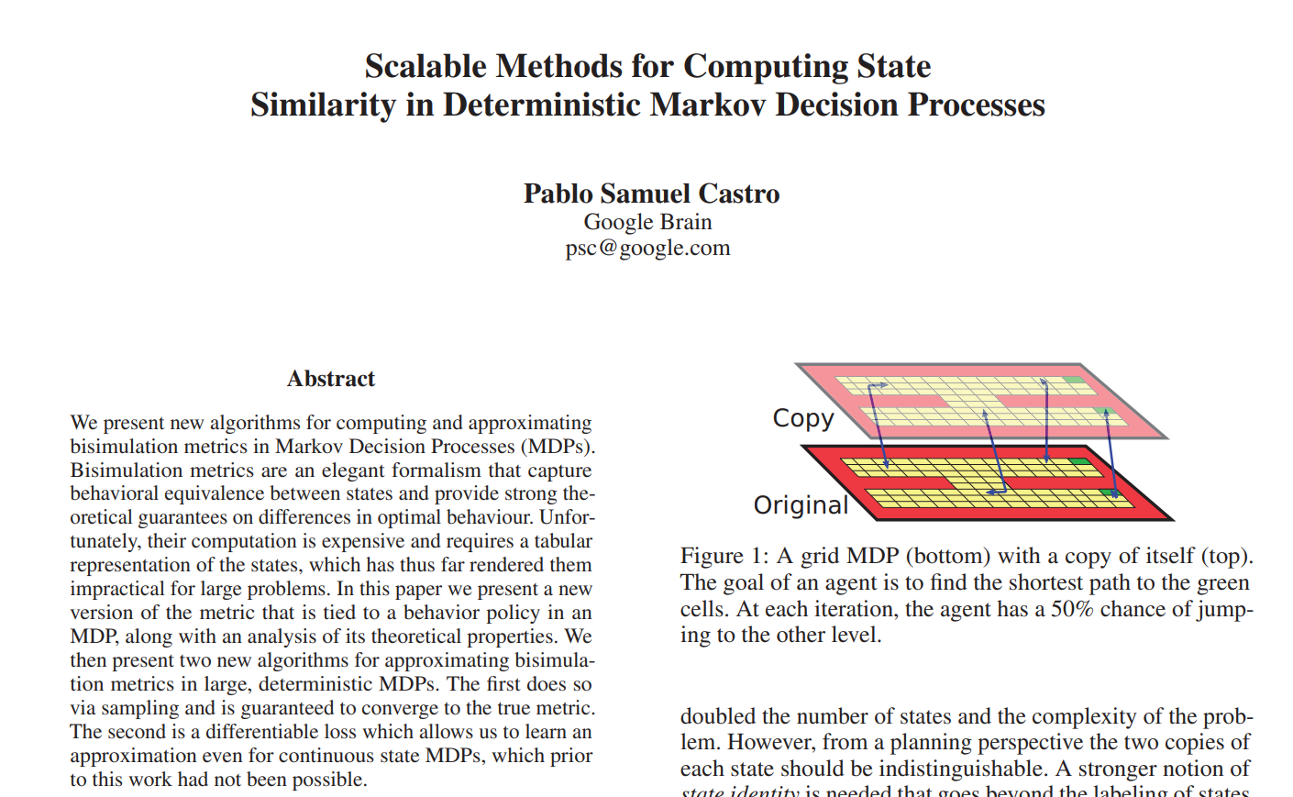
Further Reading
Computing metrics on MDPs in a scalable way.

Slide 49
Lax Bisimulation
Equivalence relation $B$on MDP satisfying
$sBs^{′}↔∀a∈A, ∃b∈A:(r\left(s, a\right)=r\left(s^{′}, b\right)$ and $∀C∈S/B$, $T\left(s, a, C\right)=T\left(s^{′}, b C\right))$

Slide 50
Lax Bisimulation
Equivalence relation $B$on MDP satisfying
$sBs^{′}↔∀a∈A, ∃b∈A:(r\left(s, a\right)=r\left(s^{′}, b\right)$ and $∀C∈S/B$, $T\left(s, a, C\right)=T\left(s^{′}, b C\right))$
s and s’ are lax bisimilar iff

Slide 51
Lax Bisimulation
Equivalence relation $B$on MDP satisfying
$sBs^{′}↔∀a∈A, ∃b∈A:(r\left(s, a\right)=r\left(s^{′}, b\right)$ and $∀C∈S/B$, $T\left(s, a, C\right)=T\left(s^{′}, b C\right))$
for every action there is another action

Slide 52
Lax Bisimulation
Equivalence relation $B$on MDP satisfying
$sBs^{′}↔∀a∈A, ∃b∈A:(r\left(s, a\right)=r\left(s^{′}, b\right)$ and $∀C∈S/B$, $T\left(s, a, C\right)=T\left(s^{′}, b C\right))$
rewards are invariant

Slide 53
Lax Bisimulation
Equivalence relation $B$on MDP satisfying
$sBs^{′}↔∀a∈A, ∃b∈A:(r\left(s, a\right)=r\left(s^{′}, b\right)$ and $∀C∈S/B$, $T\left(s, a, C\right)=T\left(s^{′}, b C\right))$
and for each block in the partition

Slide 54
Lax Bisimulation
Equivalence relation $B$on MDP satisfying
$sBs^{′}↔∀a∈A, ∃b∈A:(r\left(s, a\right)=r\left(s^{′}, b\right)$ and $∀C∈S/B$, $T\left(s, a, C\right)=T\left(s^{′}, b C\right))$
transition probabilities are invariant

Slide 55
Lax Bisimulation
Equivalence relation $B$on MDP satisfying
$sBs^{′}↔∀a∈A, ∃b∈A:(r\left(s, a\right)=r\left(s^{′}, b\right)$ and $∀C∈S/B$, $T\left(s, a, C\right)=T\left(s^{′}, b C\right))$
Intuitively: $s, a$ and $s^{′}, b$ are equivalent if
> They have the same rewards
> They have the same transition probabilities to other blocks in the partition $S/B$

Slide 56
Homomorphism
Structure-preserving map $f$ between similar algebraic structures such that
Examples:
Linear map between vector spaces
Exponential function between the reals and the positive reals
Group representation between a group and the general linear group

Slide 57
MDP Homomorphisms
Map original MDP → abstract MDP, preserve dynamics (Ravindran & Barto 2001)

Slide 58
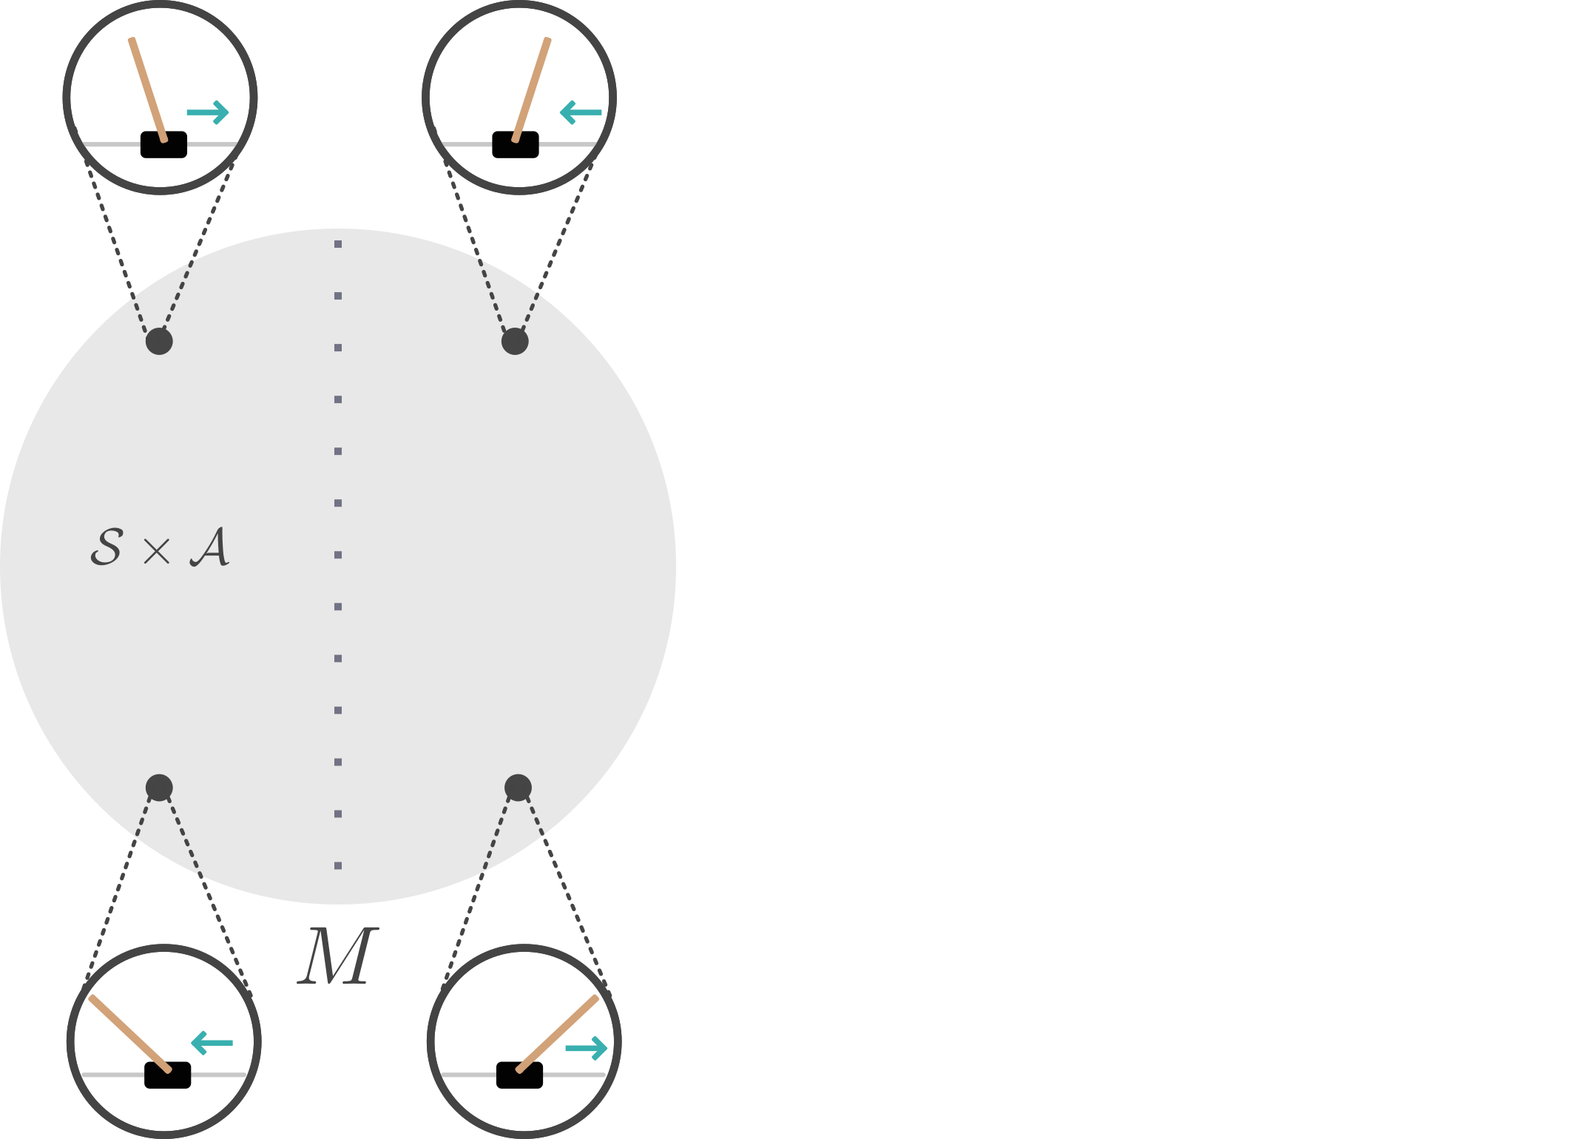
MDP Homomorphisms
Map original MDP → abstract MDP, preserve dynamics (Ravindran & Barto 2001)
Original problem
Notes:
given an mdp with symmetries

Slide 59
MDP Homomorphisms
Map original MDP → abstract MDP, preserve dynamics (Ravindran & Barto 2001)
Original problem
Notes:
given an mdp with symmetries

Slide 60
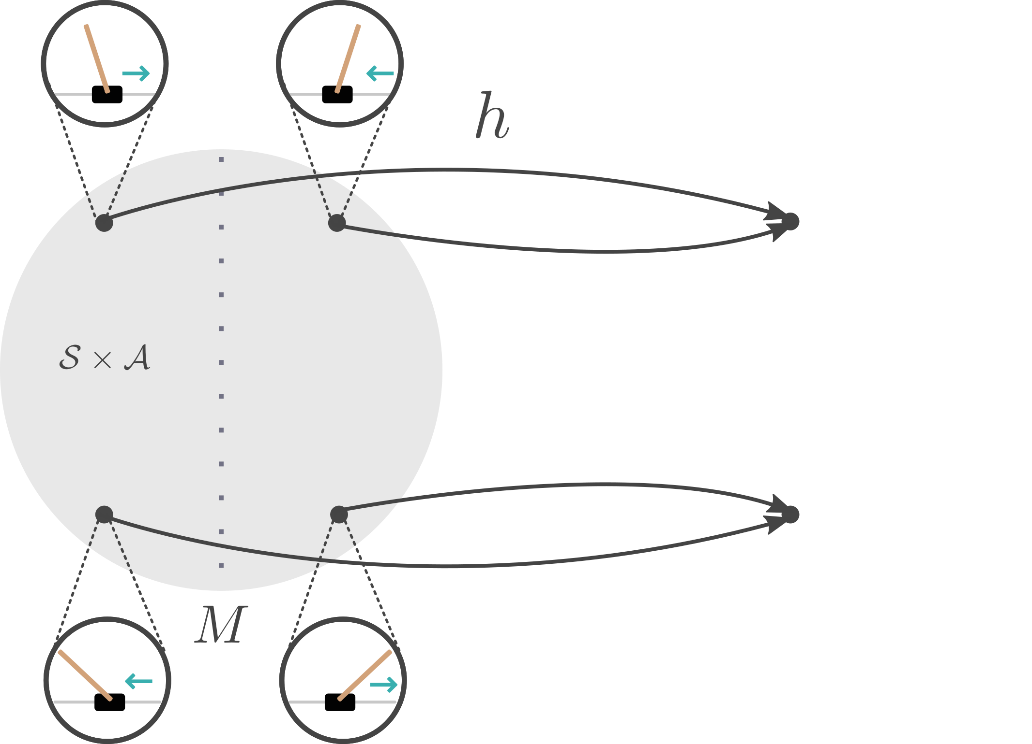
MDP Homomorphisms
Map original MDP → abstract MDP, preserve dynamics (Ravindran & Barto 2001)
MDP Homomorphism
Original problem
Notes:
we can define a corresponding mdp homomorphism

Slide 61
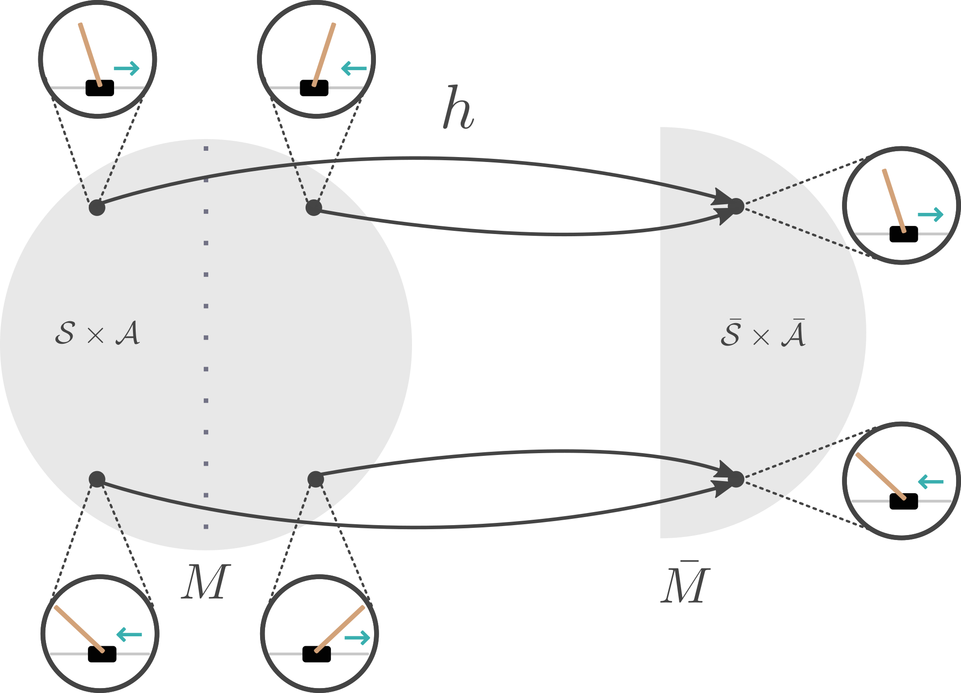
MDP Homomorphisms
Map original MDP → abstract MDP, preserve dynamics (Ravindran & Barto 2001)
MDP Homomorphism
Original problem Reduced problem
Notes:
such that symmetric state action pairs are mapped to the same point

Slide 62
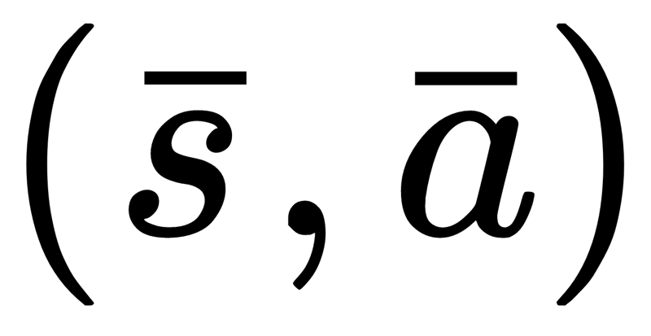
MDP Homomorphisms
Map original MDP → abstract MDP, preserve dynamics (Ravindran & Barto 2001)
MDP Homomorphism
Original problem Reduced problem
Notes:
such that symmetric state action pairs are mapped to the same point

Slide 63
MDP Homomorphism
Tuple of surjections $h=(f, \{k_{s}|s∈S\})$
$$f:S→\overline{S}$$
$$k_{s}:A_{s}→{\overline{A}}_{f(s)}$$
from $M=\left(S, A, T, R\right)→\overline{M}=(\overline{S}, \overline{A}, \overline{T}, \overline{R})$such that
Rewards are preserved:
$R\left(s, a\right)=\overline{R}\left(f\left(s\right), k_{s}\left(a\right) \right)$ $∀s^{′}∈S, a∈A_{s}$
Transitions are preserved:
$T\left(s, a, {\left[s^{′}\right]}_{B}\right)=\overline{T}\left(f\left(s\right), k_{s}\left(a\right), f\left(s^{′}\right)\right)$ $∀s^{′}∈S, a∈A_{s}$
$\overline{M}$ is a homomorphic image of $M$

Slide 64
Symmetries & MDP Homomorphism
Let $h\left(s, a\right)=\left(f\left(s\right), k_{s}\left(a\right)\right)=\left(\overline{s}, \overline{a}\right)$
Two state-action pairs $\left(s, a\right)$ and $(gs, ga)$ are $h$-equivalent
$$h\left(s, a\right)=\left(\overline{s}, \overline{a}\right)=h(gs, ga)$$
MDP homomorphism preserves MDP dynamics:
$$R\left(s, a\right)=\overline{R}(\overline{s}, \overline{a})=R(gs, ga)$$
$$T\left(s^{′} | s, a\right)=\overline{T}\left(\overline{s}′ | \overline{s},\overline{a}\right)=T(gs^{′}|gs, ga)$$
and are symmetric state-action pairs and have the same

Slide 65
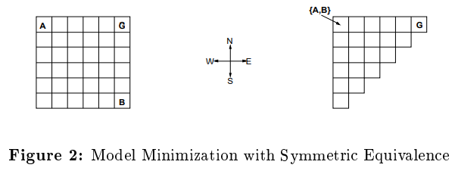
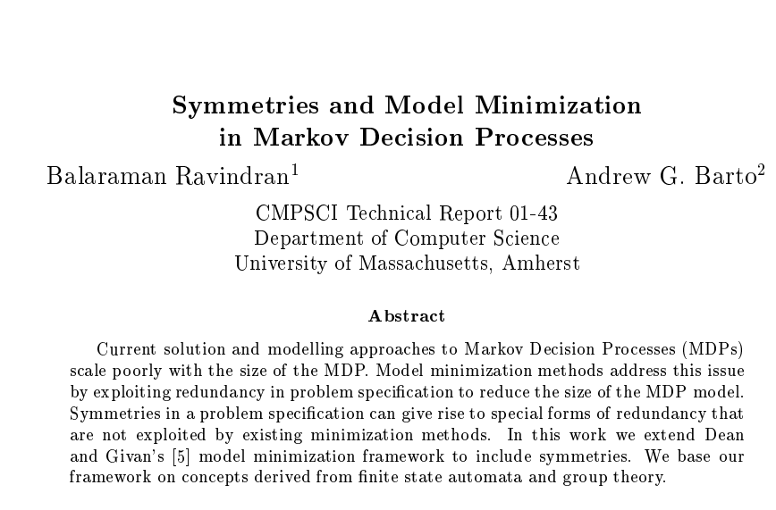
Formalizes MDP Homomorphisms.
Makes connection to symmetries in MDPs.
Shows that optimal policy is preserved.

Slide 66
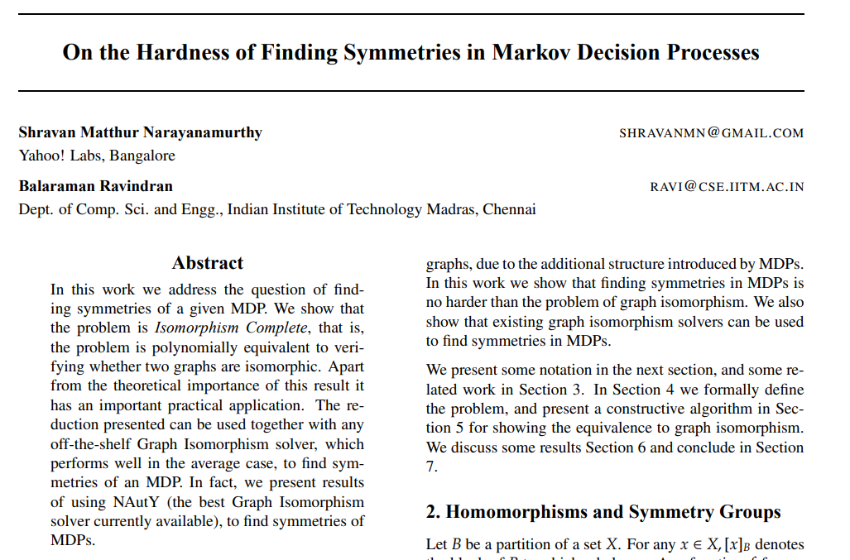
Finding symmetries in MDPs is Isomorphism Complete.
Can use Graph Isomorphism solver to find symmetries.

Slide 67
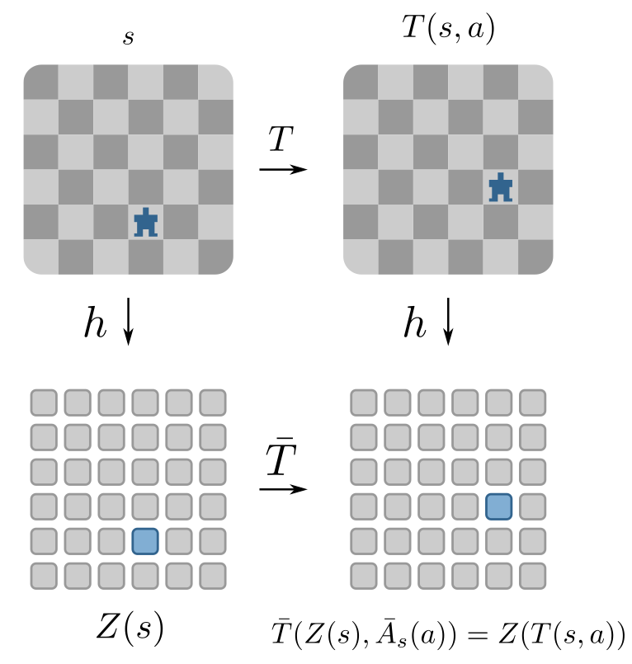
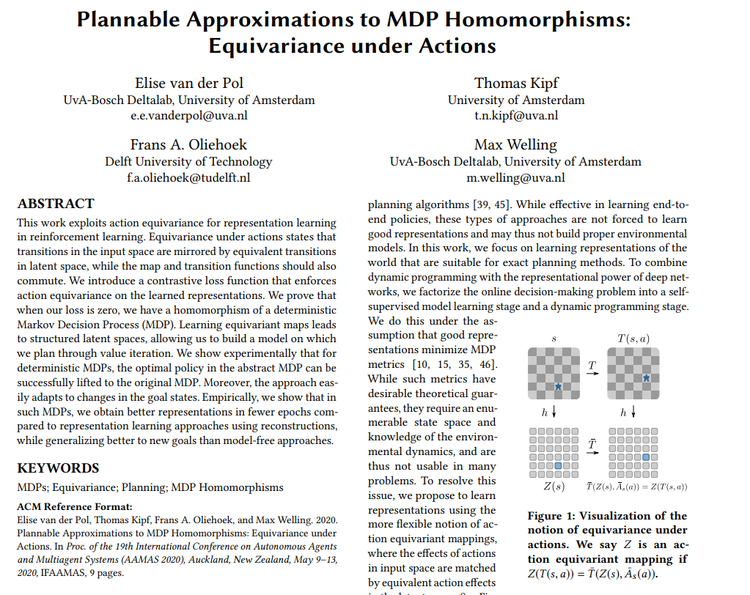
Learn representations of states and actions in RL
Main insight: equivariance under actions
Network becomes structure-preserving map
→ MDP Homomorphism

Slide 68
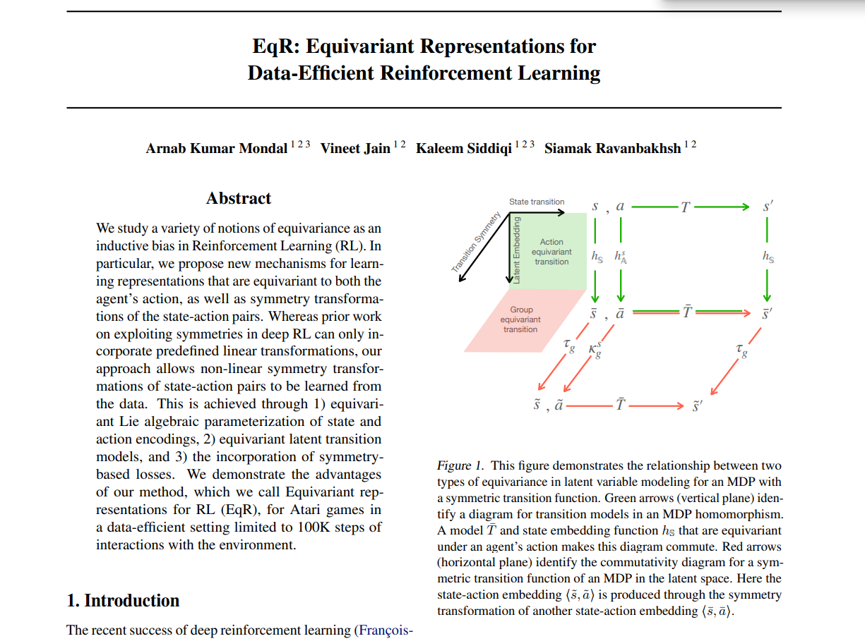
Learning equivariant representations for RL.
Equivariant to actions and group symmetries.
Improves data efficiency.

Slide 69
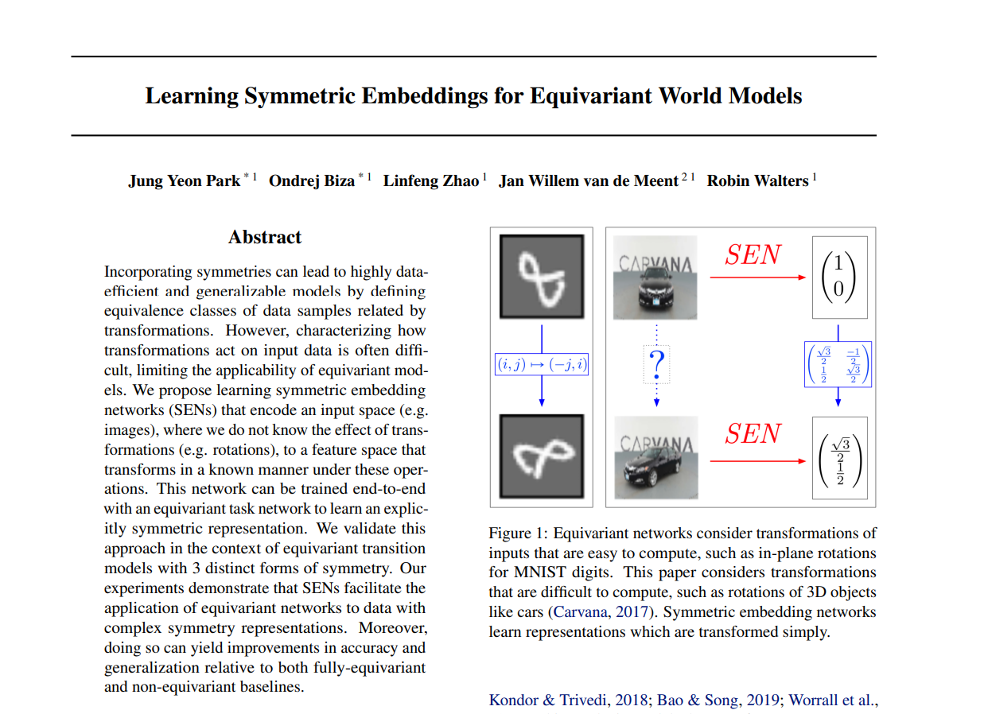
Setting: input transformations can’t be described.
Combine embedding network + equivariant world model.
Learn approximately equivariant model.

Slide 70
Break

Slide 71
MDP Homomorphic Networks:
Group Symmetries in Reinforcement Learning
Elise van der Pol ᐧ Daniel E. Worrall ᐧ Herke van Hoof ᐧ Frans A. Oliehoek ᐧ Max Welling

Slide 72
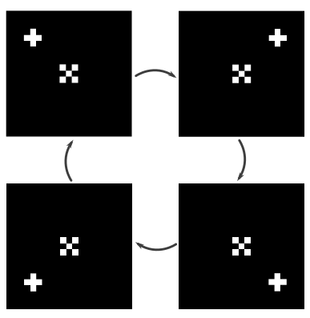
MDP Homomorphic Networks:
Group Symmetries in Reinforcement Learning
(van der Pol, Worrall, van Hoof, Oliehoek & Welling, NeurIPS 2020)

Slide 73
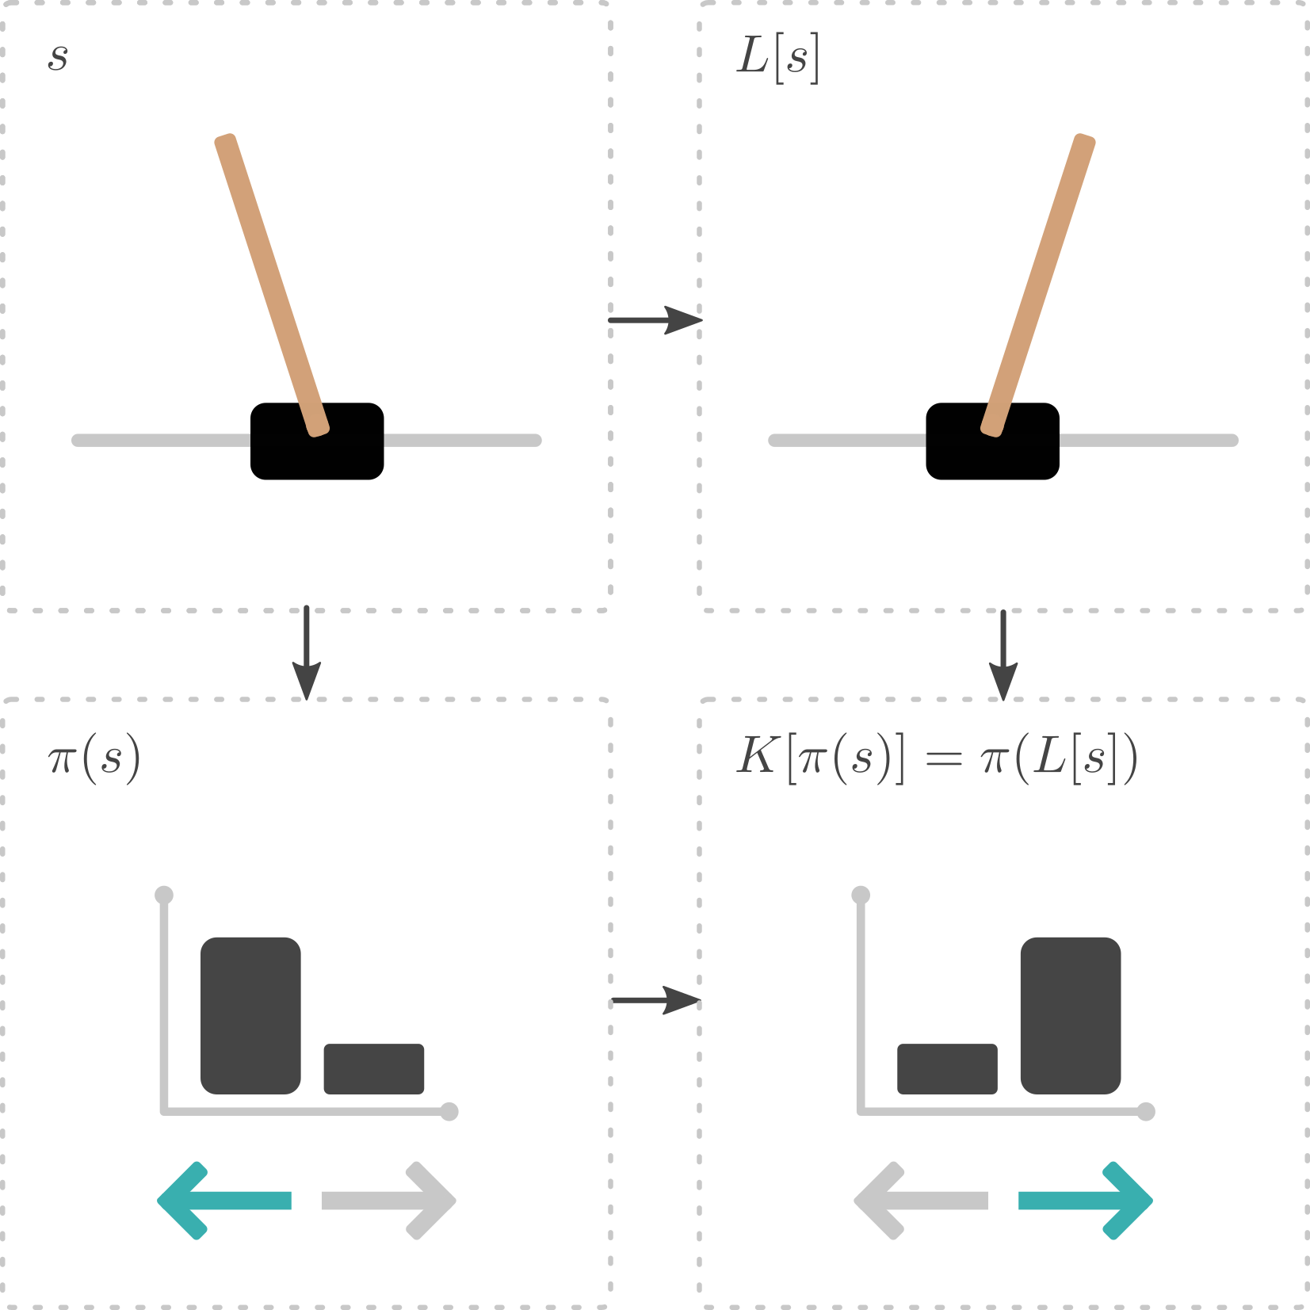
MDP Homomorphic Networks:
Group Symmetries in Reinforcement Learning
(van der Pol, Worrall, van Hoof, Oliehoek & Welling, NeurIPS 2020)

Slide 74
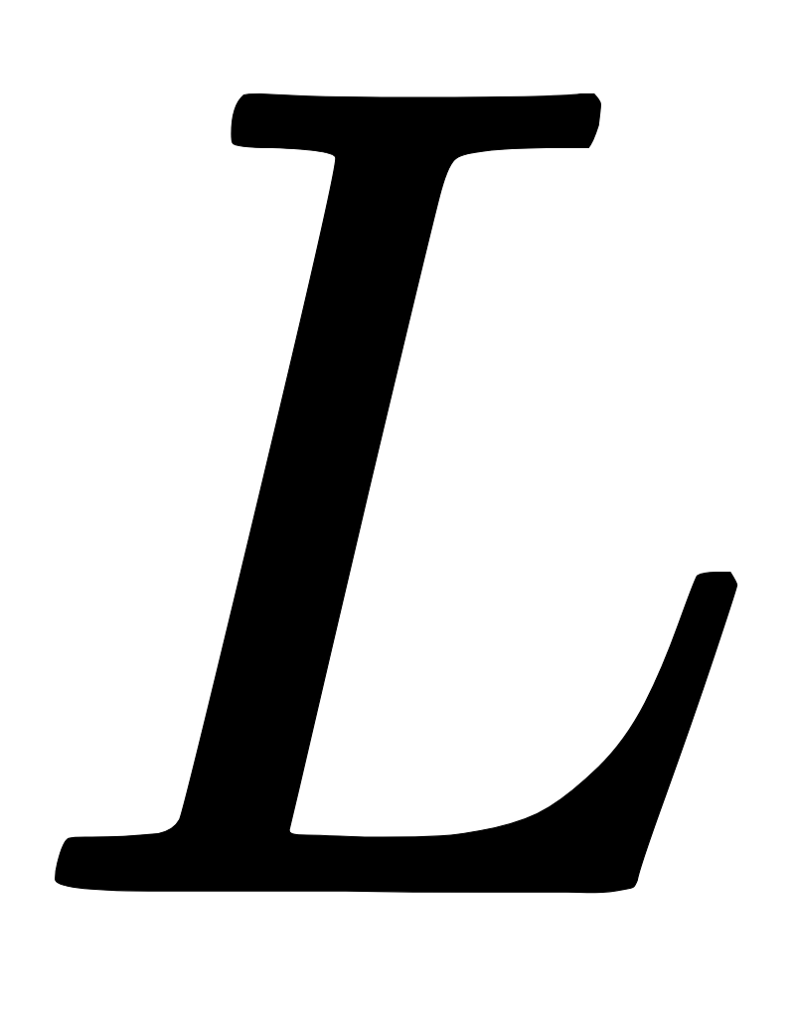
MDP Homomorphic Networks:
Group Symmetries in Reinforcement Learning
Symmetric (s, a) pairs have the same policy :
is a transformation on states, a transformation on policies
(van der Pol, Worrall, van Hoof, Oliehoek & Welling, NeurIPS 2020)

Slide 75
MDP Homomorphic Networks:
Group Symmetries in Reinforcement Learning
Symmetric (s, a) pairs have the same policy :
is a transformation on states, a transformation on policies
(van der Pol, Worrall, van Hoof, Oliehoek & Welling, NeurIPS 2020)
MDP homomorphic networks exploit symmetries in reinforcement learning

Slide 76
MDP Homomorphic Networks
We bridge MDP homomorphisms and equivariant networks

Slide 77
MDP Homomorphic Networks
We bridge MDP homomorphisms and equivariant networks
MDP Homomorphism
Problem with symmetries Reduced problem

Slide 78
MDP Homomorphic Networks
We bridge MDP homomorphisms and equivariant networks
We create deep networks constrained by MDP homomorphisms that enforce equivariance
-> Allows us to implicitly plan/learn in the abstract MDP

Slide 79
MDP Homomorphic Networks
We bridge MDP homomorphisms and equivariant networks
We create deep networks constrained by MDP homomorphisms that enforce equivariance
We introduce a new method, the Symmetrizer, to construct equivariant weights

Slide 80
Constructing Equivariant Layers
Symmetrizer:
S(W) turns W into an equivariant matrix

Slide 81
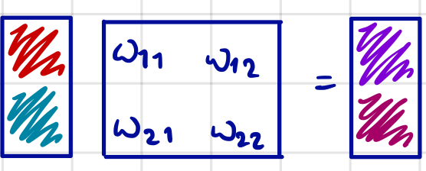
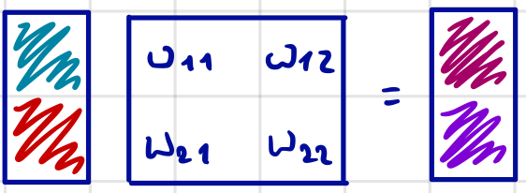
Intuition behind symmetrizer
We want flip(W·x) = W·flip(x):
x W W·x
This is the case if
flip(x) W W·flip(x)

Slide 82
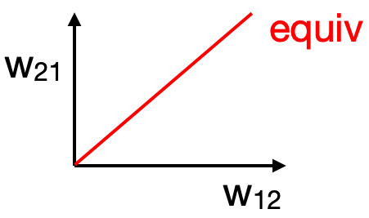
Projection onto equivariant subspace

Slide 83
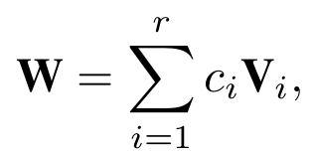
Preserving Equivariance
Before training:
Sample many weight matrices
Project them onto equivariant subspace using Symmetrizer
Compute basis $\{V_{i}\}_{i=1}^{r}$for equivariant subspace using SVD
During training:
Neural network weight is linear combination of equivariant basis weights
Train coefficients (e.g. with RL algorithm), keep basis weights fixed
learnable
fixed

Slide 84
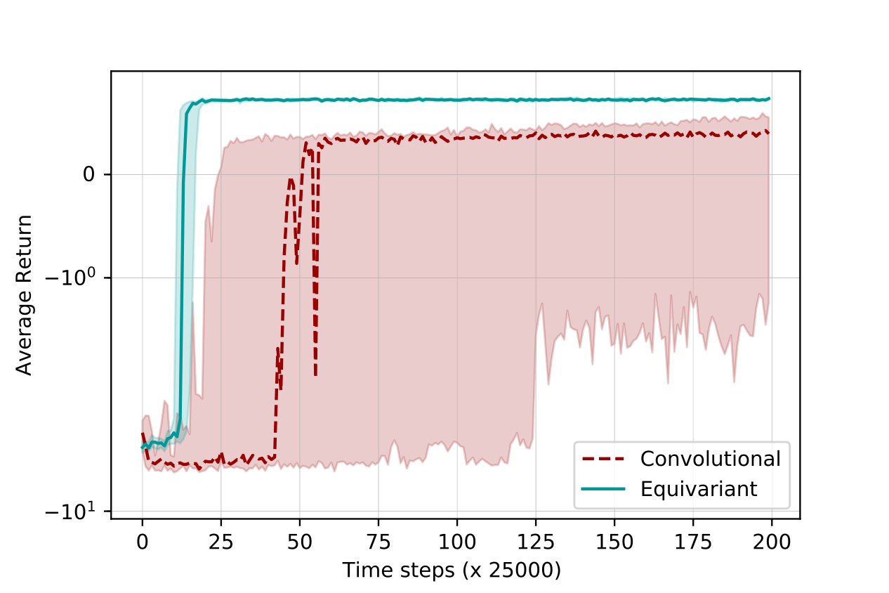
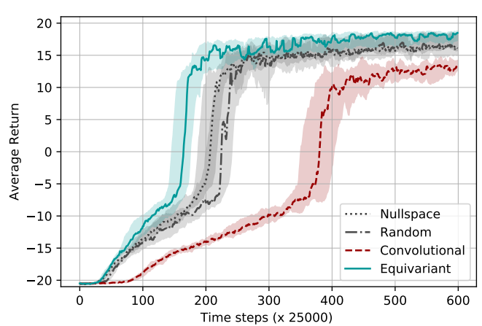
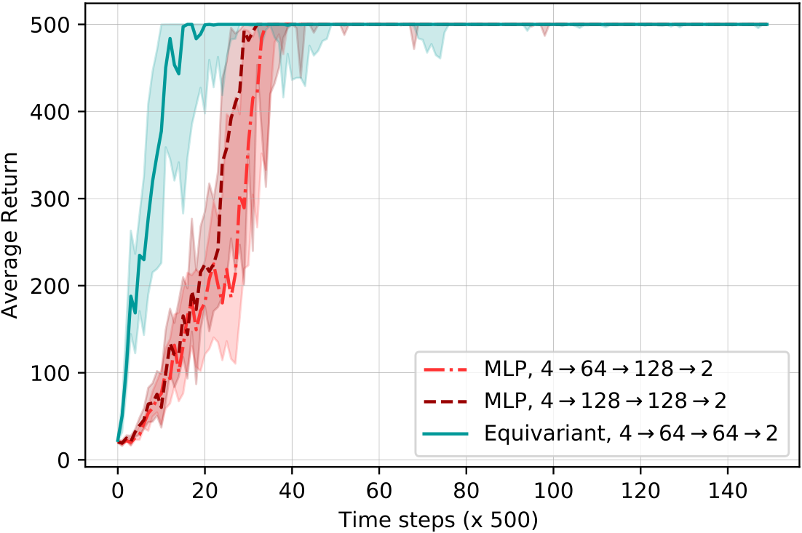
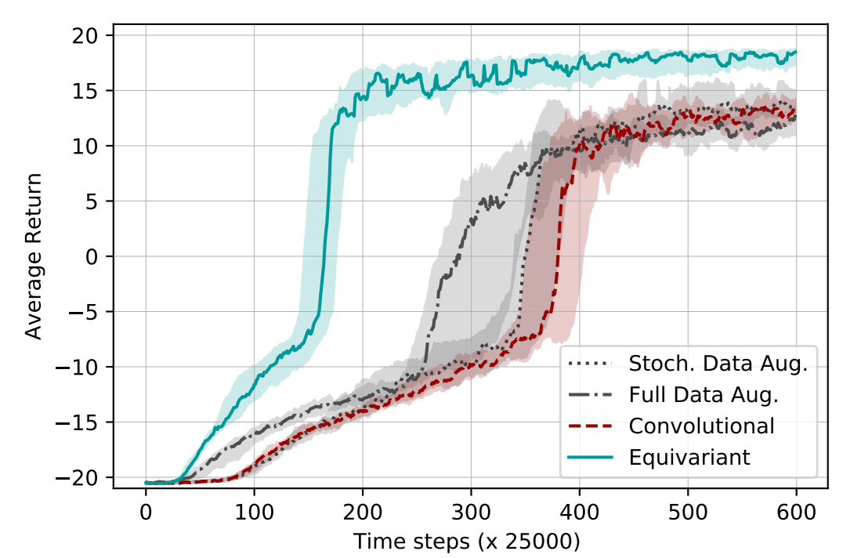
MDP Homomorphic Networks
Cartpole
2 element symmetry group
Grid World
4 element symmetry group
Pong
2 element symmetry group
x 10000
Fewer interactions with the world needed

Slide 85
Conclusion
Fewer interactions needed to obtain good policies with MDP Homomorphic networks
Useful in reinforcement learning problems that exhibit group symmetry
Symmetrizer: automatically constructs equivariant layers

Slide 86
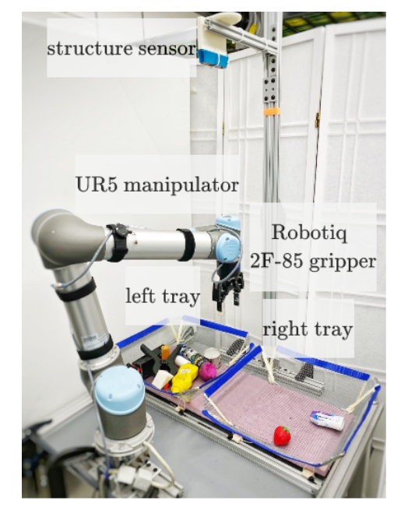
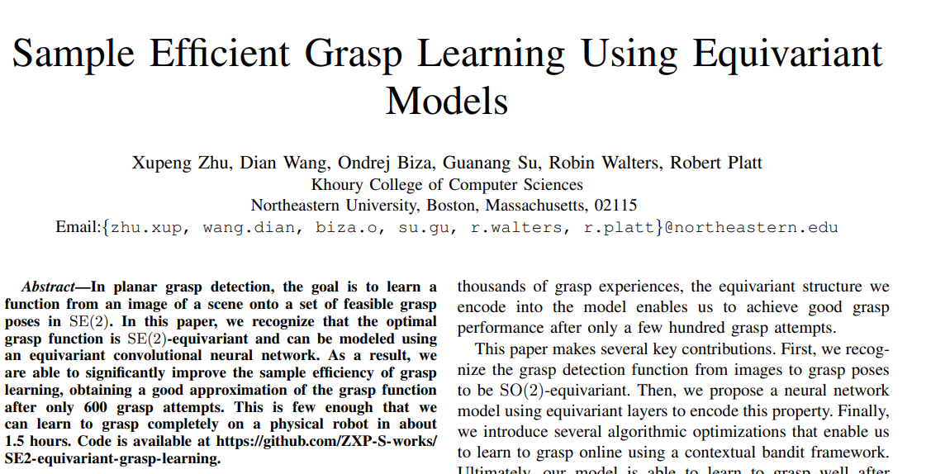
Further Reading
Equivariant neural network for grasp learning.
Learn to grasp on a physical robot in 1.5 hrs.

Slide 87
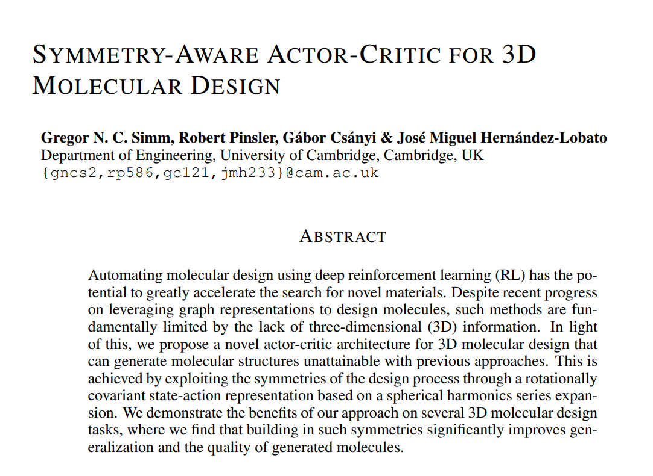
Further Reading
Equivariant policy for 3D molecular design.

Slide 88
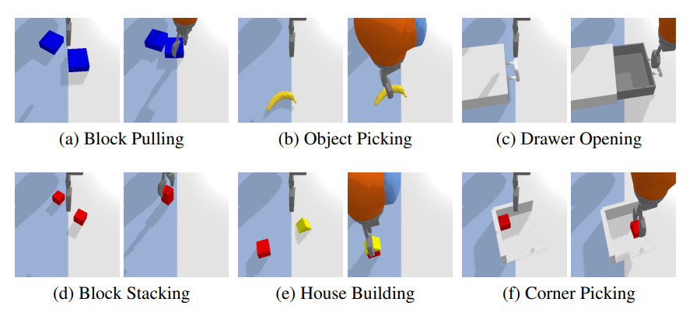
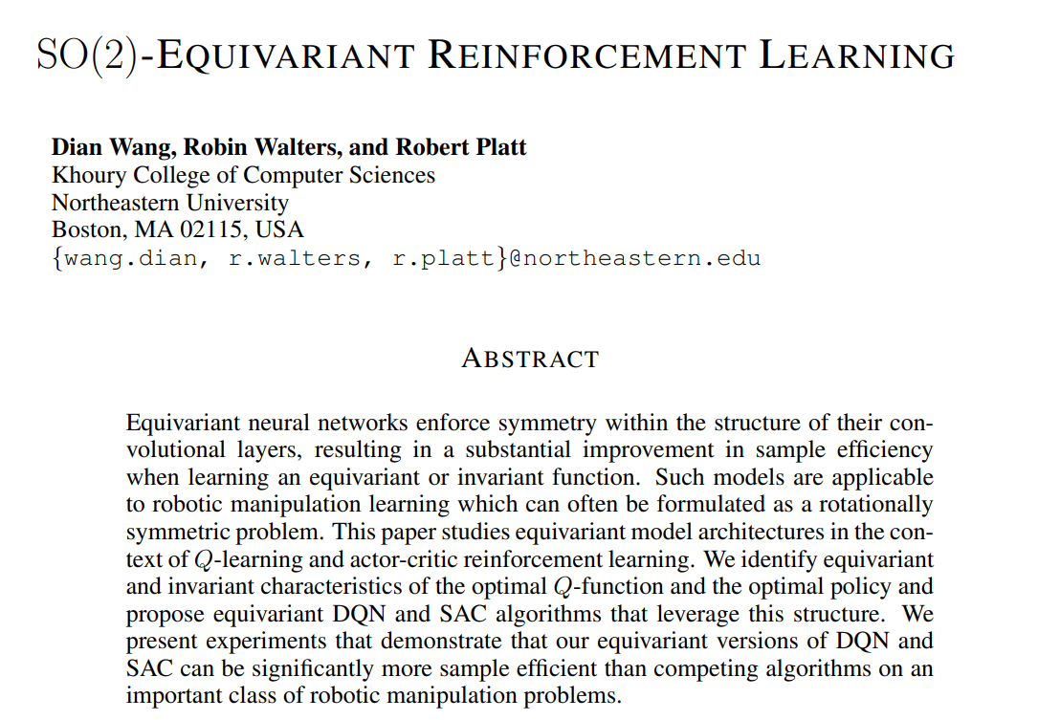
Further Reading
Equivariant SAC and DQN
Evaluate on more complex tasks

Slide 89
Multi-Agent MDP Homomorphic Networks
Elise van der Pol ᐧ Herke van Hoof ᐧ Frans A. Oliehoek ᐧ Max Welling

Slide 90
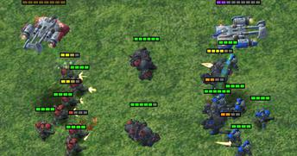
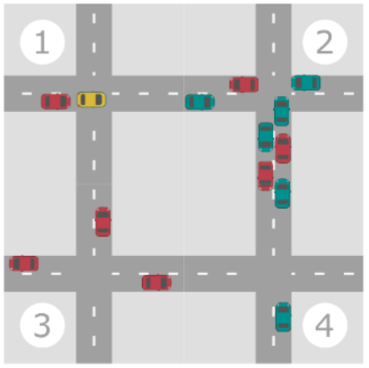
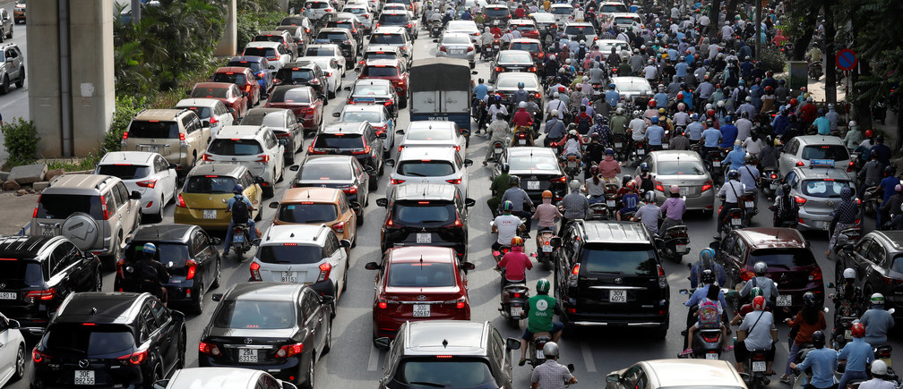
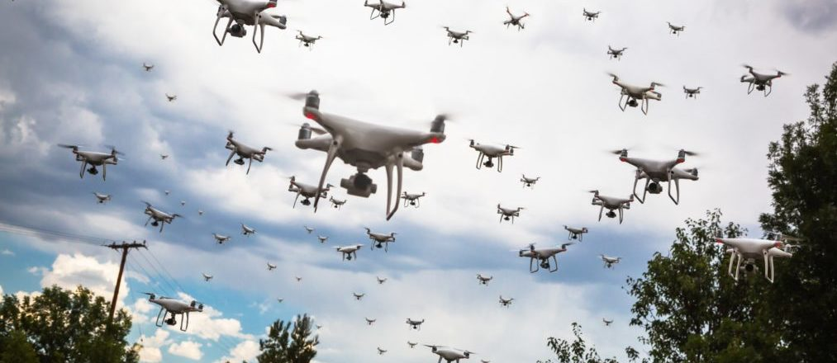
Multi-Agent Systems

Slide 91
Setting: Centralized Training, Distributed execution
Centralized controller : single agent, full communication

Slide 92
Setting: Centralized Training, Distributed execution
Network per agent + communication
Single network
communication
communication
communication
communication
Centralized controller : single agent Distributed controllers: local

Slide 93
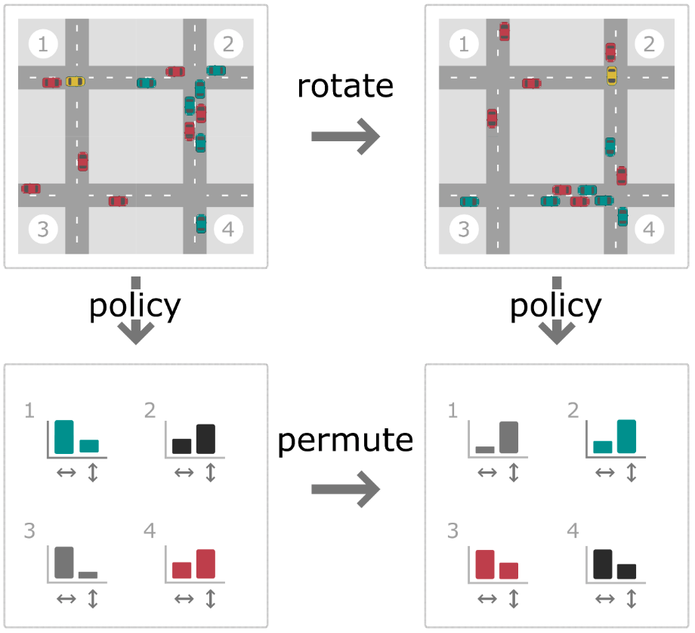
Global symmetries in multi-agent decision problems
Equivariance constraint on global states and joint policies.

Slide 94
Global symmetries in multi-agent systems
Equivariance to group symmetries: successful in single agent RL
Local equivariance ≠ global equivariance
Single agent approaches: only applicable with centralized controllers

Slide 95
Multi-Agent MDP Homomorphic Networks
(van der Pol, van Hoof, Oliehoek & Welling, ICLR 2022)
Use global symmetries with only local computation & local communication
Local equivariance constraints allow for distributed global symmetry.
communication
communication
communication
communication

Slide 96
Distributed Execution in Message Passing Networks
Node = agent
Edge = difference vector of agent coordinates

Slide 97
Distributed Execution in Message Passing Networks
Encode

Slide 98
Distributed Execution in Message Passing Networks
Encode
Messages

Slide 99
Distributed Execution in Message Passing Networks
Encode
Messages
Aggregation

Slide 100
Distributed Execution in Message Passing Networks
Encode
Messages
Aggregation
Node Update

Slide 101
Distributed Execution in Message Passing Networks
Encode
Messages
Aggregation
Node Update
Policy

Slide 102
Distributed Execution in Message Passing Networks
Encode
Messages
Aggregation
Node Update
Policy
Require only local information + local communication at execution time.

Slide 103
Globally Equivariant Distributed Execution
Encode
Messages
Aggregation
Node Update
Policy

Slide 104
Globally Equivariant Distributed Execution
Encode
Equivariance constraint on encoder
Messages
Aggregation
Node Update
Policy

Slide 105
Globally Equivariant Distributed Execution
Encode
Equivariance constraint on encoder
Messages
Equivariance constraint on messages
Aggregation
Node Update
Policy

Slide 106
Globally Equivariant Distributed Execution
Encode
Equivariance constraint on encoder
Messages
Equivariance constraint on messages
Aggregation
Node Update
Equivariance constraint on node updates
Policy

Slide 107
Globally Equivariant Distributed Execution
Encode
Equivariance constraint on encoder
Messages
Equivariance constraint on messages
Aggregation
Node Update
Equivariance constraint on node updates
Policy
Equivariance constraint on local policies

Slide 108
Globally Equivariant Distributed Execution
Encode
Equivariance constraint on encoder
Messages
Equivariance constraint on messages
Aggregation
Node Update
Equivariance constraint on node updates
Policy
Equivariance constraint on local policies
Local equivariance constraints allow for distributed global symmetry.

Slide 109
Experiments
Wildlife monitoring
Traffic Light Control

Slide 110
Evaluation
Wildlife monitoring (↑)
(grid world coordination)
Traffic Light Control (↓)
(coordination, congestion)
M
Multi-agent MDP Homomorphic Networks: improved data efficiency
Symmetry by equivariance improves over symmetry by augmentation

Slide 111
Conclusion
Global symmetry equivariance with only local communication & local computation
Including symmetry information helps with data efficiency, especially equivariance

Slide 112
Further Reading
Defines functionally homogeneous policies in Multi-Agent MDPs.
-> Permutation symmetries between homogeneous agents.
Discusses symmetries in single-agent MDPs.

Slide 113
Further Reading
Permutation symmetries: common inductive bias for multi-agent systems.
This work makes the critic permutation invariant to speed up learning.

Slide 114
Further Reading
Exploit symmetries for improved zero-shot coordination.
Zero-shot coordination: work together without joint training or communication

Slide 115
Takeaway
MDP homomorphic networks: fewer interactions needed
Applicable in single and multi agent settings
Symmetrizer: automatically construct equivariant network weights.
Promising for robotics, chemistry.
Notes:
SO(2) Equivariant Reinforcement Learning (robotic grasping)

Slide 116
Challenges Ahead
Symmetries in factored MDPs, or under partial observability
Learning symmetries
Exploiting approximate symmetries, and partial symmetries

Slide 117
Further Reading
Learn object-oriented MDPs

Slide 118
Further Reading
Equivariance + Object-oriented MDPs

Slide 119
Further Reading
Symmetries over trajectories.

Slide 120
Further Reading
Koopman theory to obtain symmetries
(+rediscover our notion of action-equivariance)

Slide 121
Further Reading
Soft priors instead of hard architecture constraints

Slide 122
Challenges Ahead
Symmetries in factored MDPs, or under partial observability
Learning symmetries
Exploiting approximate symmetries, and partial symmetries
Find me online:
📧 evanderpol@microsoft.com
@ElisevanderPol
🌐 elisevanderpol.nl

Slide 124
Distributable Symmetries

Slide 125
Symmetrizer
turns into an equivariant matrix
Use to find basis for equivariant subspace.

Slide 126
Plannable Approximations to MDP Homomorphisms:
Equivariance under Actions
(van der Pol, Kipf, Oliehoek & Welling, AAMAS, 2020)
Main insight: equivariance under actions
→ Enforce Action-Equivariance constraints
Network becomes structure-preserving map
→ MDP Homomorphism

Slide 127
Approach - use principle of MDP homomorphism
MDP-homomorphism constraints for action-equivariance
Prevent trivial solution with negative samples (contrastive loss, triplet loss)

Slide 128
Model evaluation
Plan in latent MDP with Value Iteration
Evaluate found policy in original MDP

Slide 129
Plannable MDP Homomorphisms
Trains in much fewer epochs than reconstruction baselines
CartPole-v0 in 100 trajectories
Able to generalize over objects & goals
Task: deliver key to corner
Abstract MDP. Nodes: abstract states, edges: abstract transitions, color: predicted value.
Plan performance per epoch

Slide 130
Conclusion
Action equivariance for representations in model-based RL
Contrastive loss learns an MDP homomorphism
Better exact planning compared to reconstruction & non-contrastive baselines
See the paper for more details! (van der Pol, Kipf, Oliehoek & Welling, AAMAS 2020)

